Slide 1

Slope One Algorithm

Slide 2
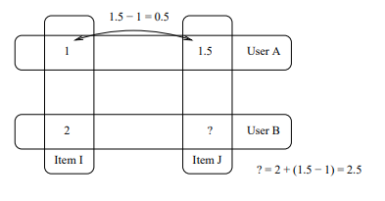
Slope One Schema
Collaborative Filtering Algorithm
Predicting how a User will rate a given item based on other user ratings.
Accounts both information
other users who rated the same item
other items rated by the same user
Simple and Efficient
Produces accurate recommendations

Slide 3
Step 1: Rating Matrix
Rows = Users
Columns = Movies
 | Movie1 | Movie2 | Movie3
User1 | 3 | 4 | 4
User2 | 2 | 4 | 1
User3 | 2 | - | 3
Rating Matrix

Slide 4
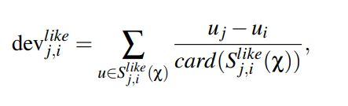
Step2: Calculate Average Item Differences
Mathematical Formula:
 | Movie1 | Movie2 | Movie3
User1 | 3 | 4 | 4
User2 | 2 | 4 | 1
User3 | 2 | - | 3
Consider the ratings given by users to different pairs of movies.
Then calculate the difference between movies where users have rated same movies.
For example,
For Movie1 and Movie2, User1 and User2 has rated both the movies,
the average rating difference between them is
( (4-3) + (4-2))/2 = 1.5.
Similarly, for Movie2 and Movie 3 is
((4-4) + (4-1)) = 1.5
Rating Matrix
 | Movie 1 | Movie 2 | Movie 3
Movie 1 | 0 | 1.50 | 0.33
Movie 2 | -1.50 | 0 | -1.50
Movie 3 | -0.33 | 1.50 | 0
Average Rating Difference

Slide 5
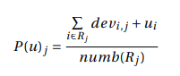
Step3: Predict Ratings
 | Movie1 | Movie2 | Movie3
User1 | 3 | 4 | 4
User2 | 2 | 4 | 1
User3 | 2 | - | 3
Mathematical Formula:
For example, to predict User 3's rating for Movie 2:
The predicted rating ‘-’, Movie2 for User3 is
((1.5 + 2) + (1.5) +3))/2 = 4
Rating Matrix
 | Movie 1 | Movie 2 | Movie 3
Movie 1 | 0 | 1.50 | 0.33
Movie 2 | -1.50 | 0 | -1.50
Movie 3 | -0.33 | 1.50 | 0
Average Rating Difference

Slide 6
Weighted Slope One
Extension of Slope One Schema
Assigns weights to the item differences based on the similarity of users who provided those ratings.
High similarity between 2 users: Higher weight
Low similarity between 2 users: Lower weight

Slide 7
Calculate weights
 | Movie1 | Movie2 | Movie3
User1 | 3 | 4 | 4
User2 | 2 | 4 | 1
User3 | 2 | - | 3
Here the weight is basically the number of items which are similarly co-rated by 2 users.
For Movie1 and Movie2, 2 users (User1 and User2) have rated similarly. Therefore, weight is 2.
Rating Matrix
 | Movie 1 | Movie 2 | Movie 3
Movie 1 | 3 | 2 | 3
Movie 2 | 2 | 2 | 3
Movie 3 | 3 | 2 | 3
Weights

Slide 8
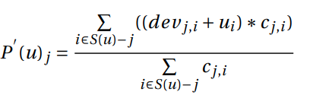
Prediction
 | Movie1 | Movie2 | Movie3
User1 | 3 | 4 | 4
User2 | 2 | 4 | 1
User3 | 2 | - | 3
Rating Matrix
 | Movie 1 | Movie 2 | Movie 3
Movie 1 | 3 | 2 | 3
Movie 2 | 2 | 2 | 3
Movie 3 | 3 | 2 | 3
The prediction for User3’s Movie2 will be
(( 1.5 + 2) *2 + (1.5 +3)*2)/4 = 4
Average Rating Difference

Slide 9
Personalized weighted Slope One
Makes recommendations to individual users by incorporating their specific preferences.
Aims to provide highly personalized recommendations by considering each user's unique rating patterns and preferences.

Slide 10
Personalized Weighted Slope One in Assignment3
Centered Cosine Similarity
where, lambda is predefined value between 0 and 1
sim(u,u') is cosine similarity of current user u' and other users u.

Slide 11
How lambda affects the result
This deviation consists of 2 parts where,
Left part represents Slope one deviation
Right part represents deviation of user based collaborative filtering.
If lambda is high, then the recommendation will be more item- item based i.e it will be predict based on the current items rating by different users.
If lambda is low, then the recommendation will be more personalized i.e it will predict ratings based on current users behaviour.

Slide 12
Conclusion
Slope One follows the item – item based recommendation system which is simpler and efficient.
when we introduce weighted Slope one approach it can be seen that it helps to personalize the user preferences by using weights.
Personalized Weighted Slope combines the cosine centered similarity with the concept of Slope One to give more personalized rating.

Slide 13
References
Reference list
Lemire, D. and Maclachlan, A. (2008). Slope One Predictors for Online Rating-Based Collaborative Filtering. arXiv:cs/0702144. [online] Available at: https://arxiv.org/abs/cs/0702144.
Tieu, B. and Ye, B. (2015). Implementation and Evaluation of a Recommender System Based on the Slope One and the Weighted Slope One Algorithm. [online] Available at: http://www.diva-portal.org/smash/get/diva2:811049/FULLTEXT01.pdf [Accessed 11 Jun. 2023].
Zhao, Z. and Zhang, J. (2018). Weighted Slope One Algorithm Optimization Based on User Similarity and Item Similarity. [online] IEEE Xplore. doi:https://doi.org/10.1109/FSKD.2018.8686857.

